Slide 1

Scotland Academy for Construction Opportunities – Highlands and Islands
16th June 2022

Slide 2
Agenda
Commission Objectives
KPIs and outputs
Commission Scope
Funding Model
Overview of commissioning process
  Delta Portal
  Award Criteria
  Timelines
Questions

Slide 3
Scotland Academy for Construction Opportunities
Objectives
A new £3m three-year commission in Scotland.
Split into two lots to best support Scottish infrastructure:
Lot 1 – Highlands and Islands [£1.3M]
  Lot 2 – Scotland Central and Southern [£1.7M]
The commission will focus on providing support to individuals entering the construction workforce to overcome any initial challenges they may face and to provide ongoing in-work support over the duration of the commission to improve the quality and longevity of work outcomes for participants.

Slide 4
Supplier commitment
The role of the supplier will be the effective transition into job roles and retention of individuals. Recognition of the local labour market vacancies will be key to the success of the commission.
The supplier will need to ensure partnerships are in place with
  Partners - who can deliver employment and site ready individuals onto the commission, and
  Employers - who will have suitable vacancies available during the commission timeframe.

Slide 5
Support for sustained employment
Opportunity has evolved from the lessons learned through previous CITB commissions which reported that long-term support for individuals starting a job in construction increases the retention of these individuals within the construction workforce.
This support will be achieved via an Employment Support Plan. The Employment Support Plan may include:
Job Coaching
Buddy system
Employer (review/support/meetings)
Mentoring
Notes:
CITB will provide Employment Support Plan.

Slide 6
KPI’s and Outputs
KPI 1: | Evidence that appropriate training and on-site experiences have taken place
 | (note: no funding attached to this but will be a pre-requisite of the commission).
KPI 2: | Job start with individual employment support plans in place
KPI 3: | 3 month sustained employment
KPI 4: | 6 month sustained employment
KPI 5: | 12-month destination report
 | (note: no funding is provided for this output).

Slide 7
Targets – Highlands and Islands
 | Targets | 22/23 | 23/24 | 24/25 | Total
KPI 1 | Experiences | 250 | 500 | 250 | 1000
 | (ESR not funded)
KPI 2 | Job Starts | 250 | 500 | 250 | 1000
KPI 3 | Sustained 3 months | 121 | 294 | 252 | 667
KPI 4 | Sustained 6 months | 24 | 75 | 101 | 200
67% of individuals starting a new job to still be employed after 3 months.
    30% of those employed at 3 months, will still be in their job at 6 months.
Notes:
Note: breakdowns may not add up exactly to percentage requirements due to rounding but they contribute towards the overall Scotland targets.

Slide 8
Commission Scope
Participants must be;
  either new entrants, career changers or not worked in construction in the last 2 years
  aged 18 years+.
Jobs must be occupations that are ‘in scope’ to CITB
Suppliers can include self-employed participants where they can evidence that the majority of their work is with a named contractor.
There will be a KPI of 15%+ attributed to Under-Represented Groups remaining in employment for 3 months.

Slide 9
Funding Model – Highlands and Islands
Decreasing funding model over 3 years
Largest proportion of payment made at 6 months to encourage sustained employment
Additional 20% of contract value allocated to performance management and data reporting
Capital Expenditure/Leasing funds available under exceptional circumstances
Notes:
The commission has been created with a decreasing funding scale – unit costs will decrease by 10% each year this is to support sustainability into the industry when the commission ends.
However, the payment value will be based on the year the new entrant started – all new starters in year 1 will receive the year 1 payments at each KPI stage and so on.
Payment will be made quarterly

Slide 10
Overachievement Bonus​
CITB want to incentivise providers to overachieve on sustained employment. Therefore, an overachievement bonus will be paid on the number of individuals who sustain employment for 6 months.​
The bonus is triggered when the provider achieves over the 30% target up to a maximum of 40%.
This bonus will be calculated annually and paid at 3 points specified in the contract.​

Slide 11
Commission Criteria
Delta Portal
Scoring/Assessment Criteria
Timelines
Notes:
Commission will be advertised on Delta portal. The following slides will provide an overview of how to access and use the portal.

Slide 12
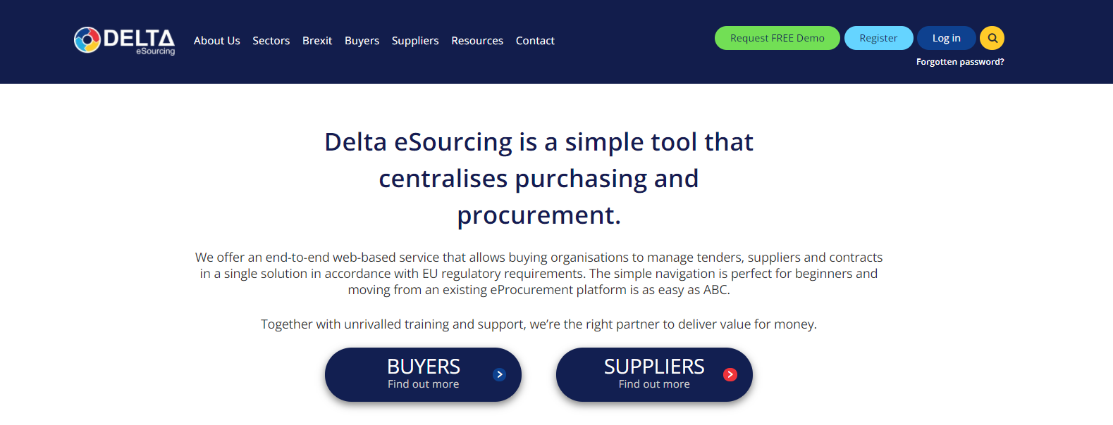
Delta – Creating an account
Procurement, Contract & Tender Management - Delta eSourcing (delta-esourcing.com)

Slide 13
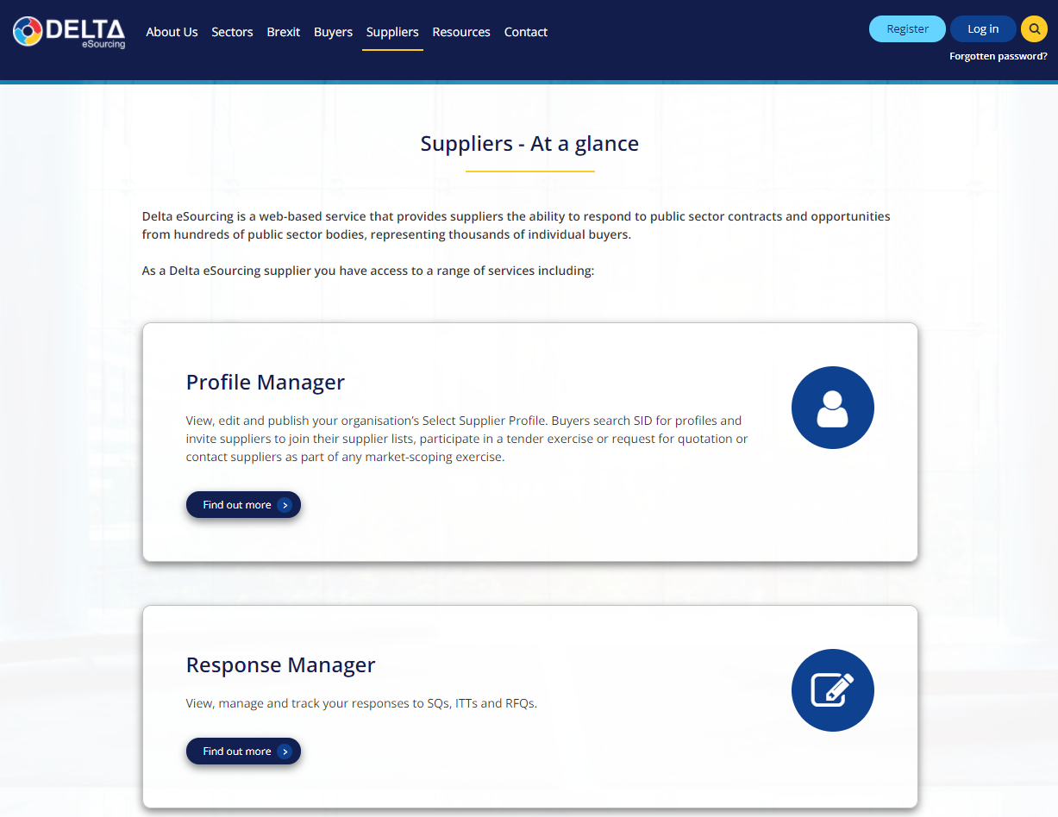
Delta – Creating an account
Register for an account

Slide 14

Delta
Delta access code:
https://www.delta-esourcing.com/respond/9DJQBCSS28

Slide 15
Scoring/Assessment Criteria
Recruiting for success - Explain how you will source the individuals, detail your initial assessment, what criteria will you apply to an employment and site ready person who has the propensity to sustain employment in the construction industry and the commitment of the individual | 25%
Quality and support - Explain how you will design and develop your support plans. Describe the suite of support interventions you will have available for use on the individual Employment and Support Plan (ESP). CITB will supply the ESP document to be submitted as evidence for the Job Start, 3- and 6-months’ support plan review which must be signed by individual and work coach/mentor. | 25%
Working with employers - Describe your links with construction employers in the area in which you intend to operate and clearly demonstrate the demand for employment in this area. Detail the employers you are working with and the likely construction occupations with current opportunities that are available. | 25%
Profile of outputs include cost breakdown - Provide forecasted outputs in the attached with number of individuals you intend to recruit into employment for Y1-Y3. Please provide an overall costing showing a breakdown of your fixed costs against the key stages / main deliverables and any expenses. | 10%
Data reporting and project management - Detail your resources, how the project will be managed and the roles of any partner organisations and their responsibilities in the governance structure. Explain how you will develop and track the new entrants to the 12 months stage and beyond and any data solutions you use to do this | 10%
Sustainability and social value - provide details of how you will sustain the support solutions on cessation of CITB funding. In addition, please detail the social value that you expect to be delivered via this project, both in the short and long-term as a consequence of the successful delivery. | 5%

Slide 16
Timelines
Issue Invitation to Tender | Monday 20th June 2022
Deadline for receipt of Clarification Requests | Monday 4th July 2022
Tender Submission Deadline | Monday 18th July 2022
Evaluation of tenders | Tuesday 19th July - Tuesday 2nd August 2022
Decision notified to all Tenderers | Monday 8th August 2022
Expiry of Standstill | Friday 19th August 2022
Contract Meetings | To start Monday 22nd August 2022
Commission Start Date | Thursday 1st September 2022

Slide 17

Any questions?

